Slide 1

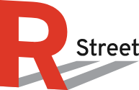
Western Power Improvement: Market Expansion, Interconnection & Transmission Siting
Invited Input to Nevada Regional Transmission Coordination Task Force
Oct. 28, 2024

Slide 2



WHO WE ARE
R Street Institute is a nonprofit, nonpartisan, public policy research organization. Our mission is to engage in policy research and outreach to promote free markets and limited, effective government.

Slide 3
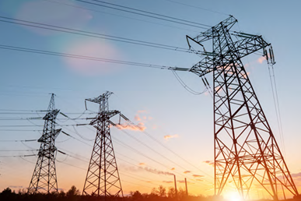
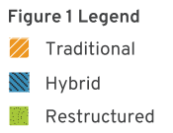
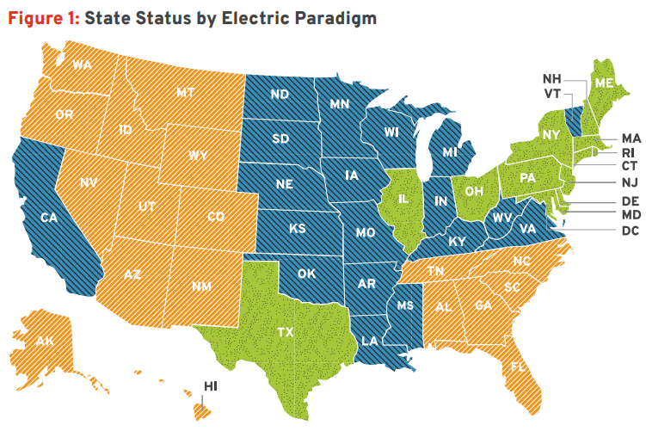
Towards a Western RTO
An RTO for the West: Opportunities and Options
RTOs generally
Overwhelming positive & growing net benefits
Overcoming myths (e.g., ghosts of Enron)
Confront (surmountable) challenges (e.g., governance, admin/expertise/legal cost)
West moving toward “hybrid” model
Organized wholesale markets
Vertically-integrated cost-of-service
Lessons from MISO & traditional SPP
Fragmented functions
Western Resource Adequacy Plan
Western Transmission Expansion Coalition
Unlike other RTO expansion
R Street Policy Study Sept. 2024
Source: R Street Electric Paradigms paper (2023)

Slide 4
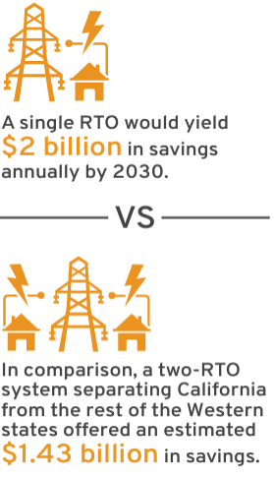
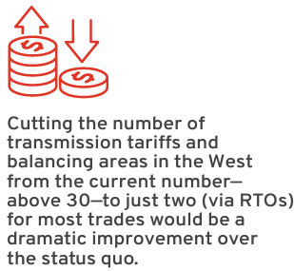
RTO West: Technical Considerations
Lower costs and improve achievement of reliability and envir. goals
Align economic motives with engineering realities
Intraregional advantages
E.g., lower barriers to entry → innovation & cost savings
E.g., superior resource dispatch
Better seams management
Agreements to manage overloads caused by loop flows
Value grows w/ future resource mix
Esp. variable & use-limited resources
Technical-governance tradeoffs
SPP Markets+ thesis

Slide 5
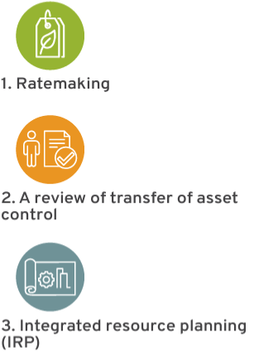
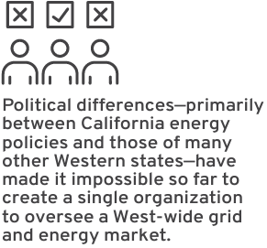
RTO West: Governance Considerations
RTOs generally: quasi-autonomous nongovernmental orgs
Improve accountability, remedy incumbent transmission owner favoritism
West specifically: CAISO governance uniqueness
States interests
Retain autonomy, better efficiency under “hybrid” than traditional model
More autonomy, less efficiency under “hybrid” than restructured model
RTO functions: integrated vs. multiple orgs
Resource adequacy: watch utility IRP-regional need alignment
Transmission: planning-operating divide
Market incrementalism: watch design, monitoring
State Autonomy Retained via Key Authorities

Slide 6
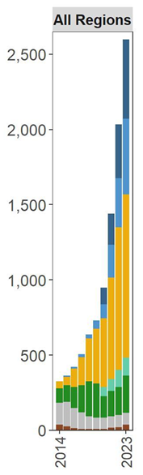
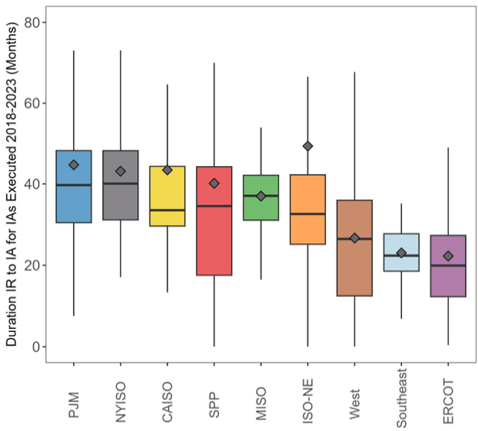
Interconnection Woes
GW
2-3x+ delays
Upgrade cost multiplying
Slow processing
RTOs inundated
Non-RTOs: far fewer requests
Order 2023… and beyond
Source: LBL graphics

Slide 7

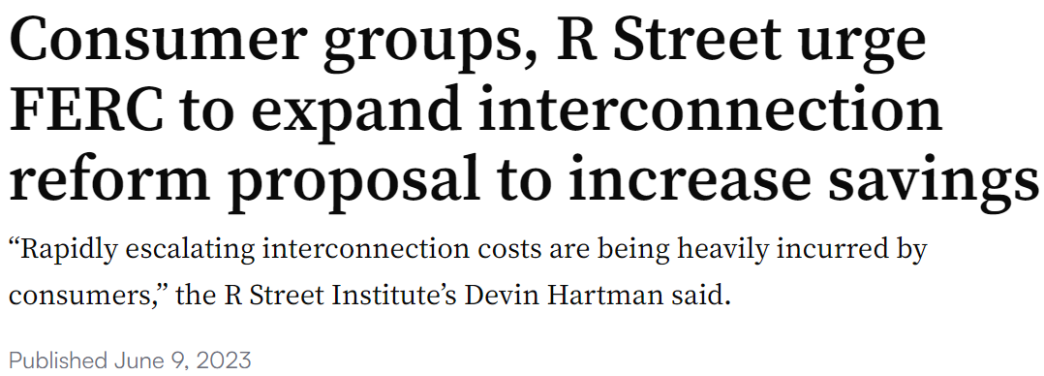
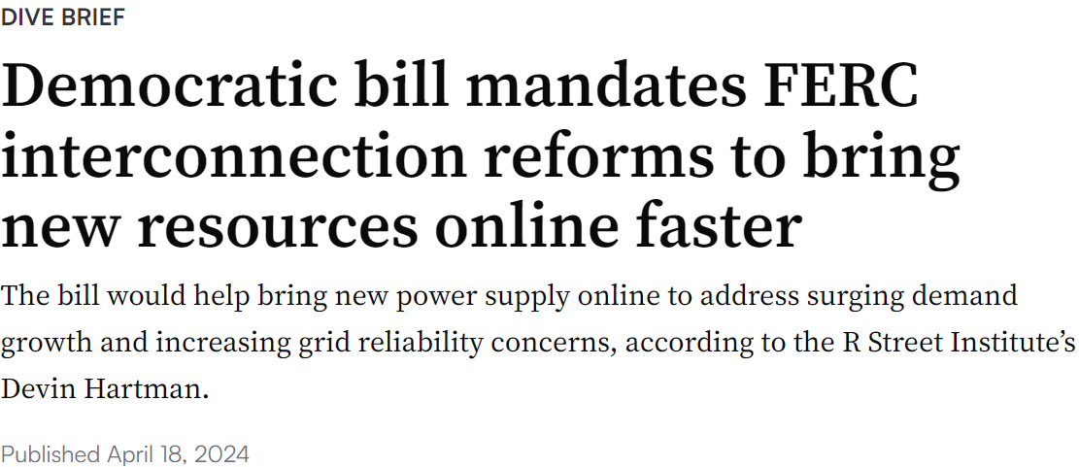

Interconnection Policy
NOPR scope narrow
Limited benefit vs expected improvements (eg MISO)
Incrementally beneficial
Organized consumer letter ahead of O2023
Clarify: delays, costs mostly passed to consumers
Motivate supplemental action
Parties sought action on letter post-O2023
Sen. Cortez-Masto’s EGIPA introduced
FERC held workshop (RSI testimony, comments)
Regions taking various indep. actions
Mixed results
Innovations and Efficiencies in Generator Interconnection Workshop

Slide 8
Outstanding Reform Priorities
Accurate & consistent study assumptions.
Adopt cost-effective network upgrades policy (emphasis on transmission planning).
Evaluate advanced transmission technologies and redispatch for upgrade solutions.
Permit fast-tracking of requests for “as-available” interconnection service.
Generator bears the risks of curtailment and congestion. Ineligible (initially) for capacity valuation.
Use advanced computing & management practices to expedite interconnection studies.
FERC likely to encourage further “bottom-up” regional improvements
(i.e., tech conf, reporting, policy statement; supplem. rulemaking unlikely)
Western Region Takeaway: Lead on Finishing Reforms

Slide 9
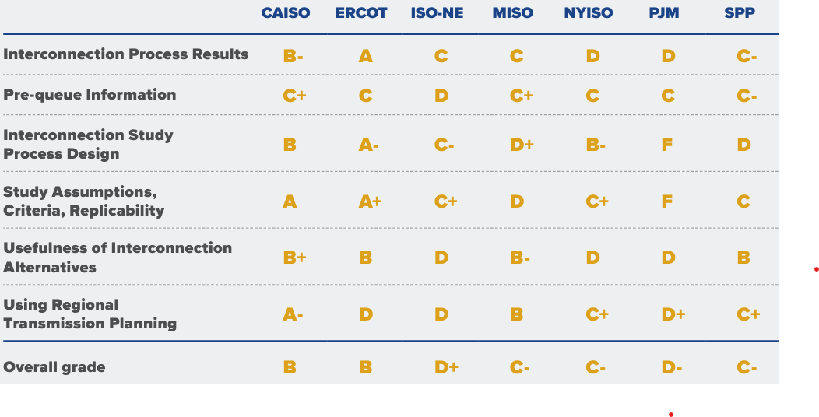
Interconnection Priorities
Source: Grid Strategies & Brattle interconnection report card (Feb. 2024)

Slide 10
Transmission Permitting & Siting
New Project Driver (2010-2020)
FERC: limited backstop authority
Unusual: often interstate infrastructure has federal preemptive authority
Senate legislation pending
State: primary jurisdiction (intra- and interstate)
Local: pronounced role, varies by state
Tribal, private authority roles
Effects:
Piecemeal, haphazard, uncoordinated across jurisdictions
Local projects often exempt
Biases favor intrastate → suppress interstate
State improvements (forthcoming paper)
Better benefits info/accounting
Incumbent/non-incumbent equivalency
Lower specious litigation risk
Legit harm considerations only, appeals process, etc.
Status quo encourages diseconomies of scale; mostly incremental reliability upgrades
Source: data from Niskanen, C Three Group

Slide 11
Load Growth Readiness
Organized, regional market adoption
Well-designed markets
Efficient transmission practices
Efficient interconnection practices
Streamlined permitting & siting
Quality consumer choice

Slide 12
Thank you!
Devin Hartman
dhartman@rstreet.org

